Slide 1
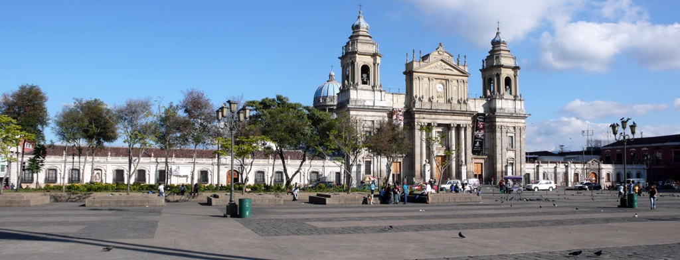
Application of Music-Encoding Technologies to Guatemalan Choirbooks Facilitating Preservation and Musicological Studies of the Colonial Repertoire
Martha E. Thomae, Julie E. Cumming, and Ichiro Fujinaga
CIRMMT, McGill University
Music Encoding Conference
Vienna, May 31st, 2019

Slide 2
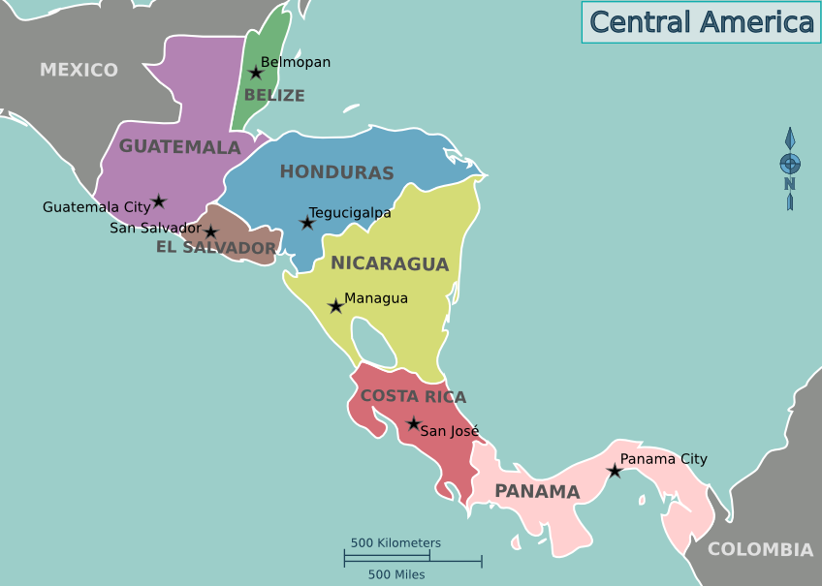
Project Goals
Preservation and dissemination of the musical content of a set of colonial music manuscripts from Guatemala
Using the tools developed at SIMSSA
Pixel.js
Calvo’s method
Interactive Classifier (IC)
Pitch finding
Scoring-up tool
Wikipedia: Central America
Notes:
Guatemala → country in Central America (just below México)
Part of the Spanish Colonial Empire
Even though colonial music is rooted in the early Western music traditions (e.g., Medieval, Renaissance, and Baroque music), little is known about how these traditions and repertoires evolved in the Spanish colonies of the Americas.
Encode the music content of these manuscripts to preserve it and make it accessible both inside and outside of the country to allow for studying this kind of topics.
Do it using …
TOOLS THAT YOU ARE GOING TO HEAR ABOUT LATER, SINCE THEY HAVE ALREADY BEEN USED FOR THE ENCODING OF MUSIC IN NEUME NOTATION

Slide 3
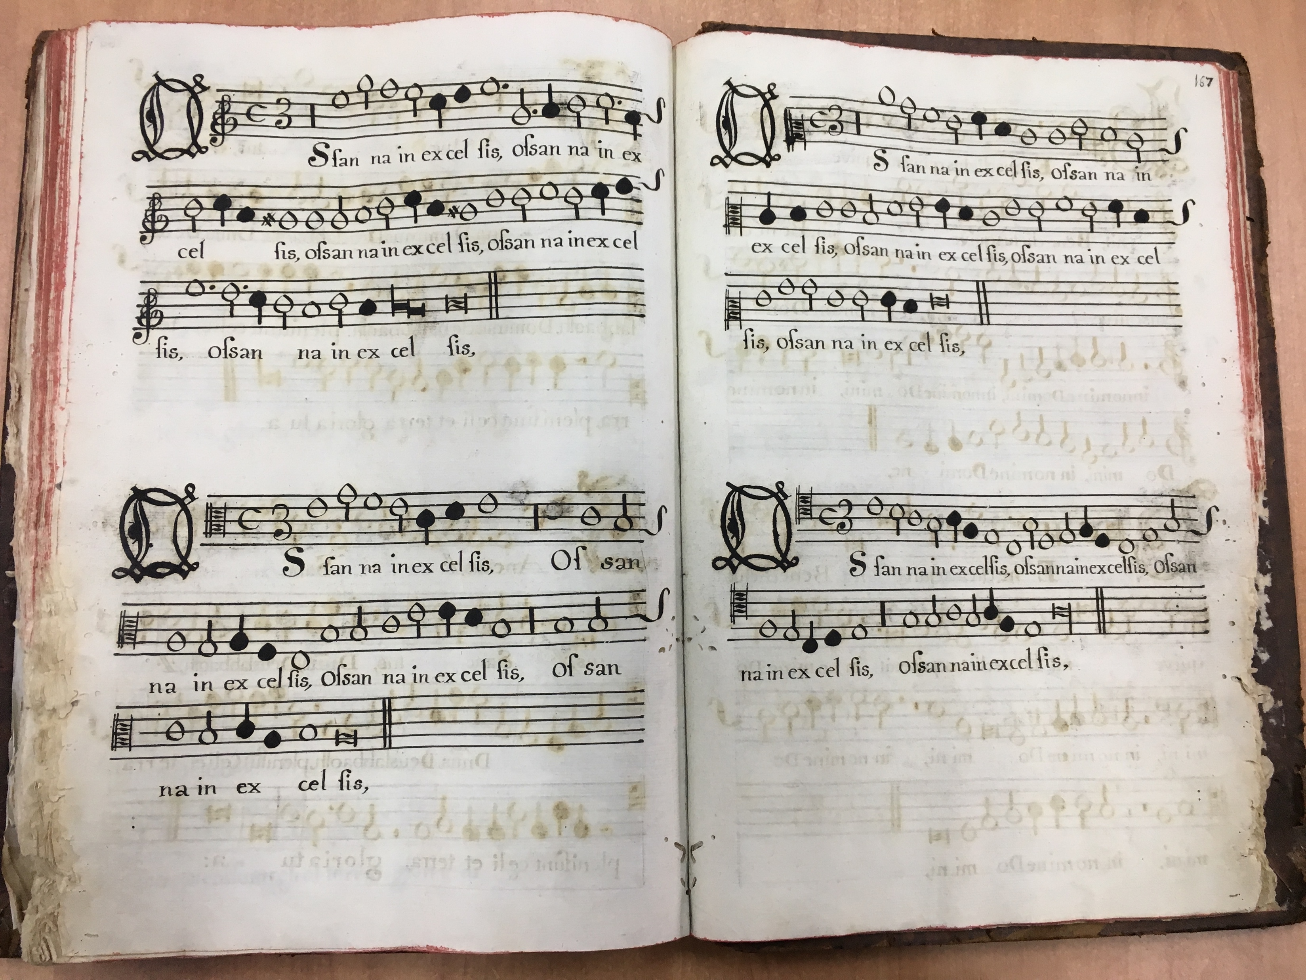
Guatemalan Choirbooks
6 manuscripts copied between XVI - XVIII
Choirbook format
Written in mensural notation
Music notation system used in Europe throughout the Late Middle Ages and the Renaissance
Notes:
The sources I will be working with are
SIX manuscript sources
Copied between the XVI and XVIII centuries
These MSS are choirbooks, that means they are written in choirbook format
And using an old system of music notation called mensural notation. This system was used in Europe throughout the …

Slide 4
Barriers for Accessing the Music
Lack of high-quality digital images
Notation style (mensural notation)
Layout (choirbook format)
Notes:
So, I consider that these choirbooks have 3 barriers for accessing their music content:
I will give more details later
SO THE IDEA IS REMOVING THESE ACCESIBILITY BARRIERS, USING THE TECHNOLOGIES DEVELOPED AT SIMSSA

Slide 5
Barriers for Accessing the Music
Lack of high-quality digital images
Notation style (mensural notation)
Layout (choirbook format)
Notes:
Lack of digital images → access restricted to people able to visit

Slide 6
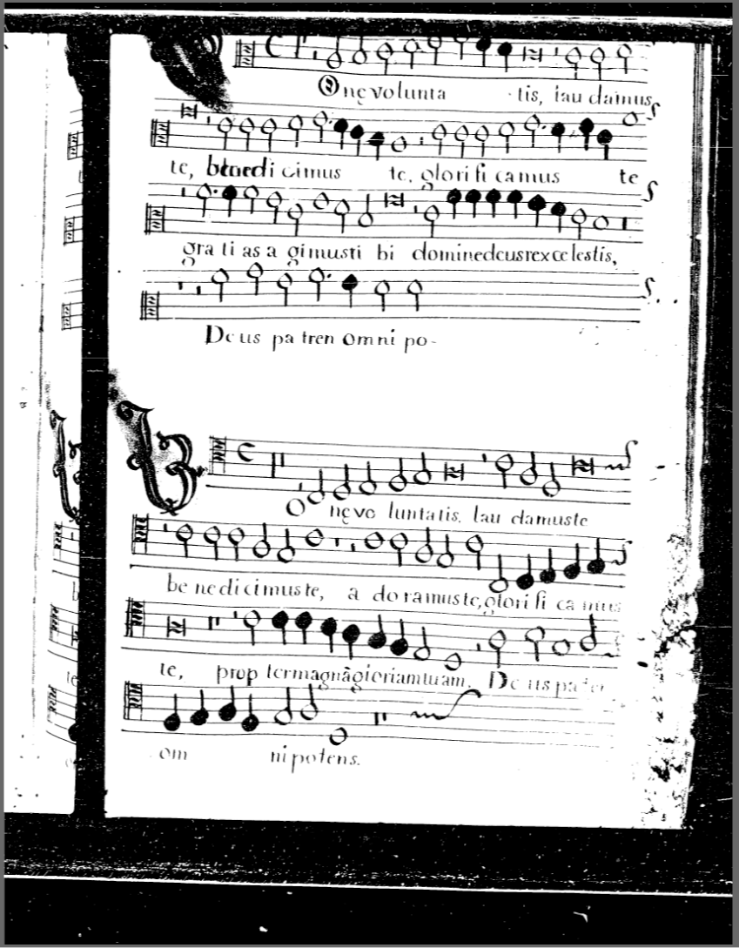
Notes:
There are digital images --> DJVU FILES from MICROFILMS (70s)
Microfilms --> images are cropped on top and bottom --> lose part of the music information
I thought that was the case : Case of MS 4 (headings with the attributions were lost)
DjVu files (without permission) --> bad quality (missing pages)
http://www0.cpdl.org/wiki/index.php/Música_Colonial_Archive
http://conan.lib.miamioh.edu/musica/data/ (Reel 9)
[from the Miami University Libraries, Ohio]
Now the original microfilms are being digitized once again by the actual archive that has these microfilms.
The quality of the digital image can only be as good as that of the microfilm itself (so, still cropped)

Slide 7
Barriers for Accessing the Music
Lack of high-quality digital images
Notation style (mensural notation)
Layout (choirbook format)
Notes:
Modern musicians cannot interpret it
Need an expert
Predecessor of our CWMN, already shares some characteristics ... [NEXT]

Slide 8
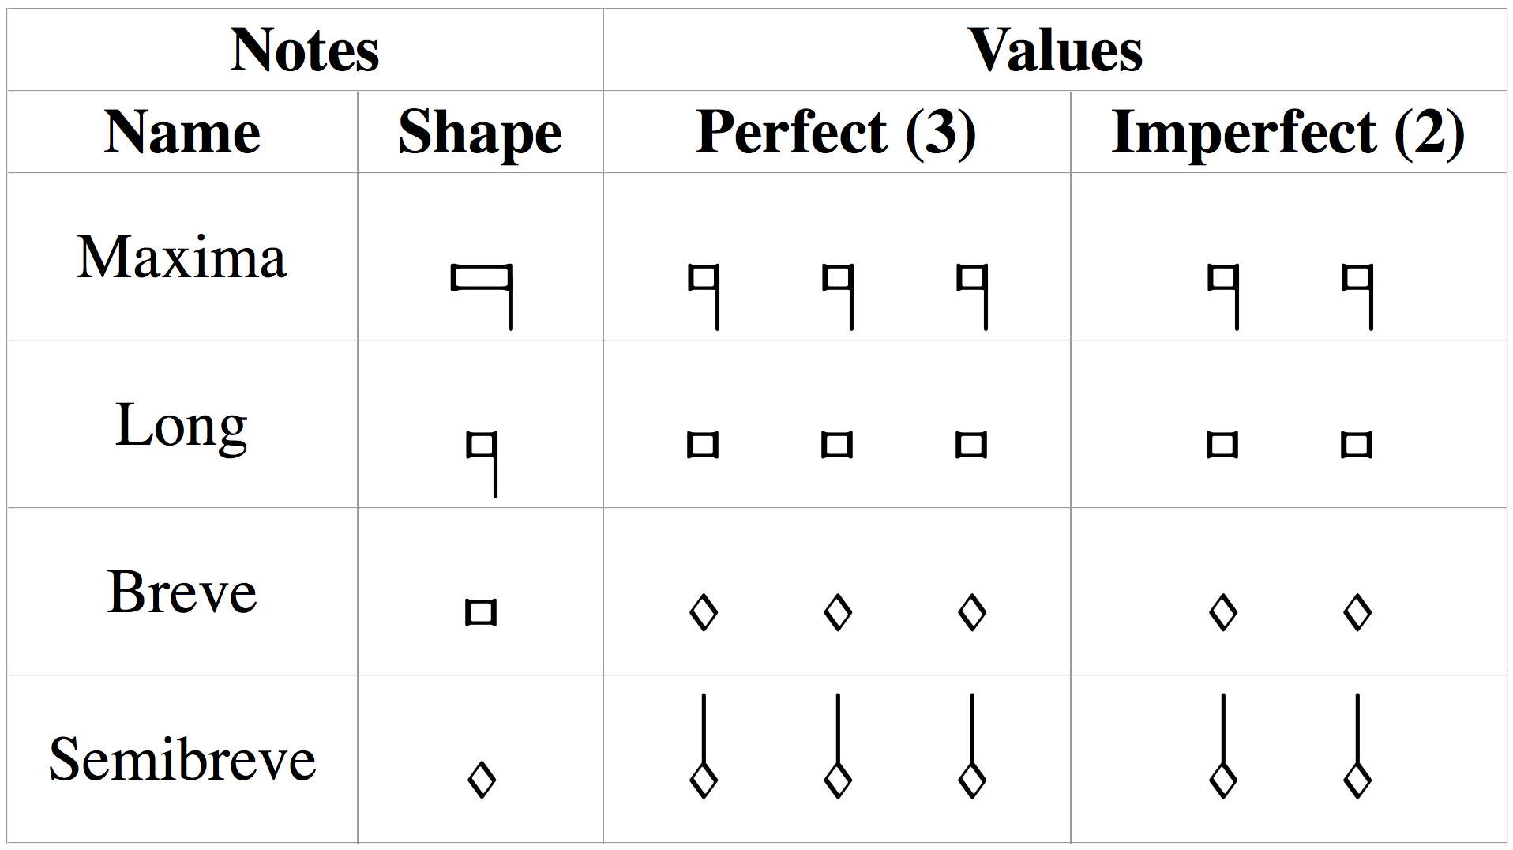
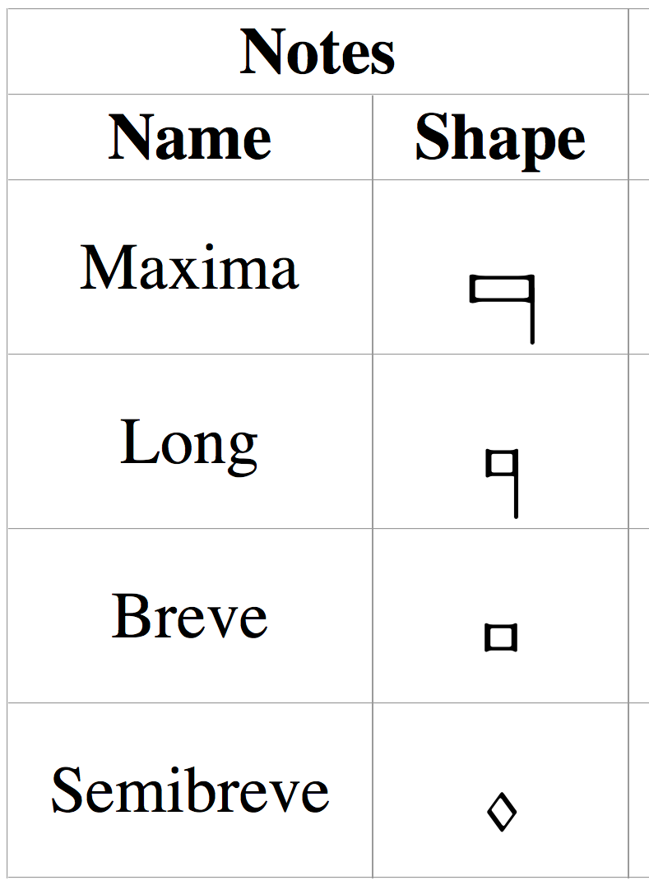


Mensural Notation
mensuration
context
longest
shortest
3 x 2 x 1 x 3 x
Notes:
Different note shapes for different note values (hierarchical system)
BUT, unlike CWMN, each of those 4 note shapes can have two different durations
Ternary (p) or Binary (i)
Two concepts: MENSURATION & Context
Conclusion: NOTE SHAPE IS NOT ENOUGH TO DETERMINE THE DURATION OF THE NOTE
There are certain rules for figuring out the duration of the notes based on the context, YOU NEED AN EXPERT WHO IS FAMILIAR WITH THESE RULES

Slide 9
Barriers for Accessing the Music
Lack of high-quality digital images
Notation style (mensural notation)
Layout (choirbook format)
SUPERIUS
ALTUS
TENOR
BASSUS
Notes:
(Explain the choirbook format layout again—animation)

Slide 10
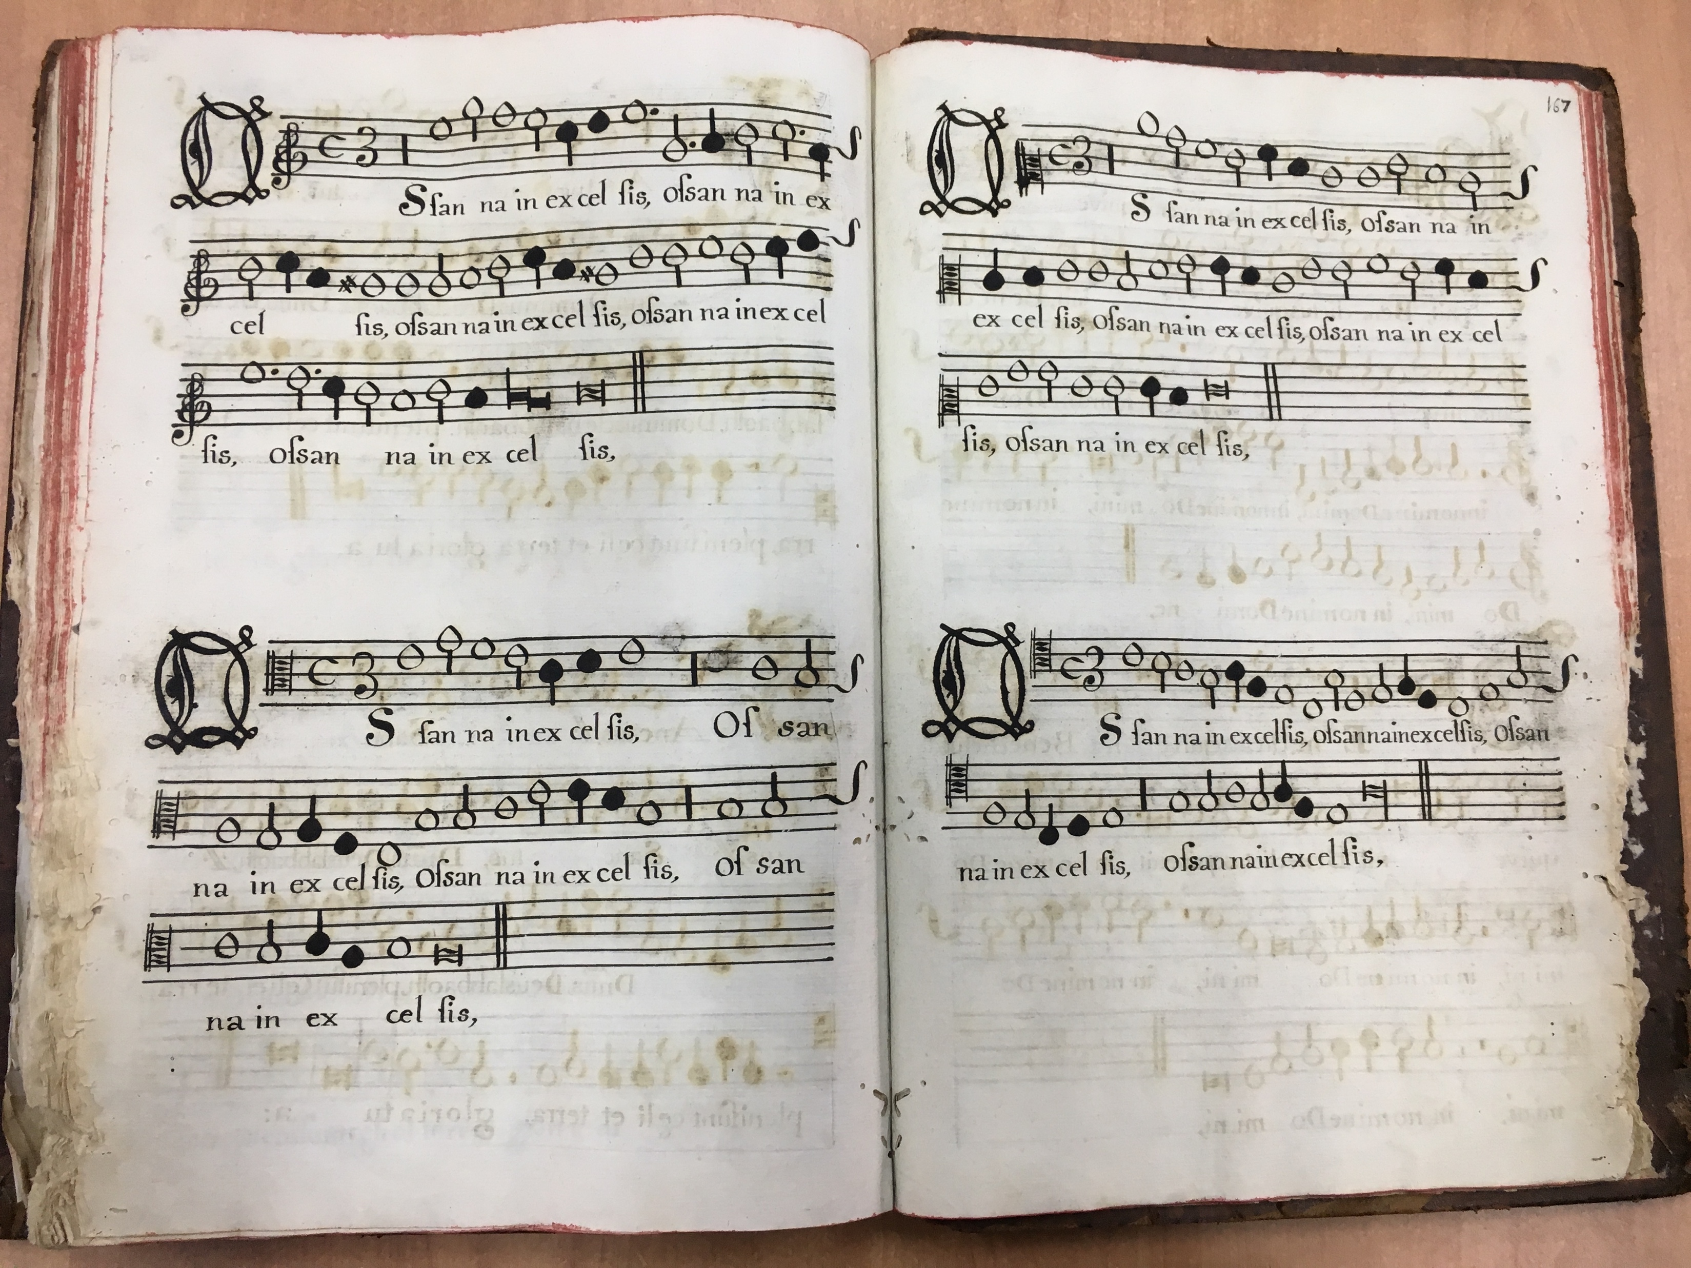
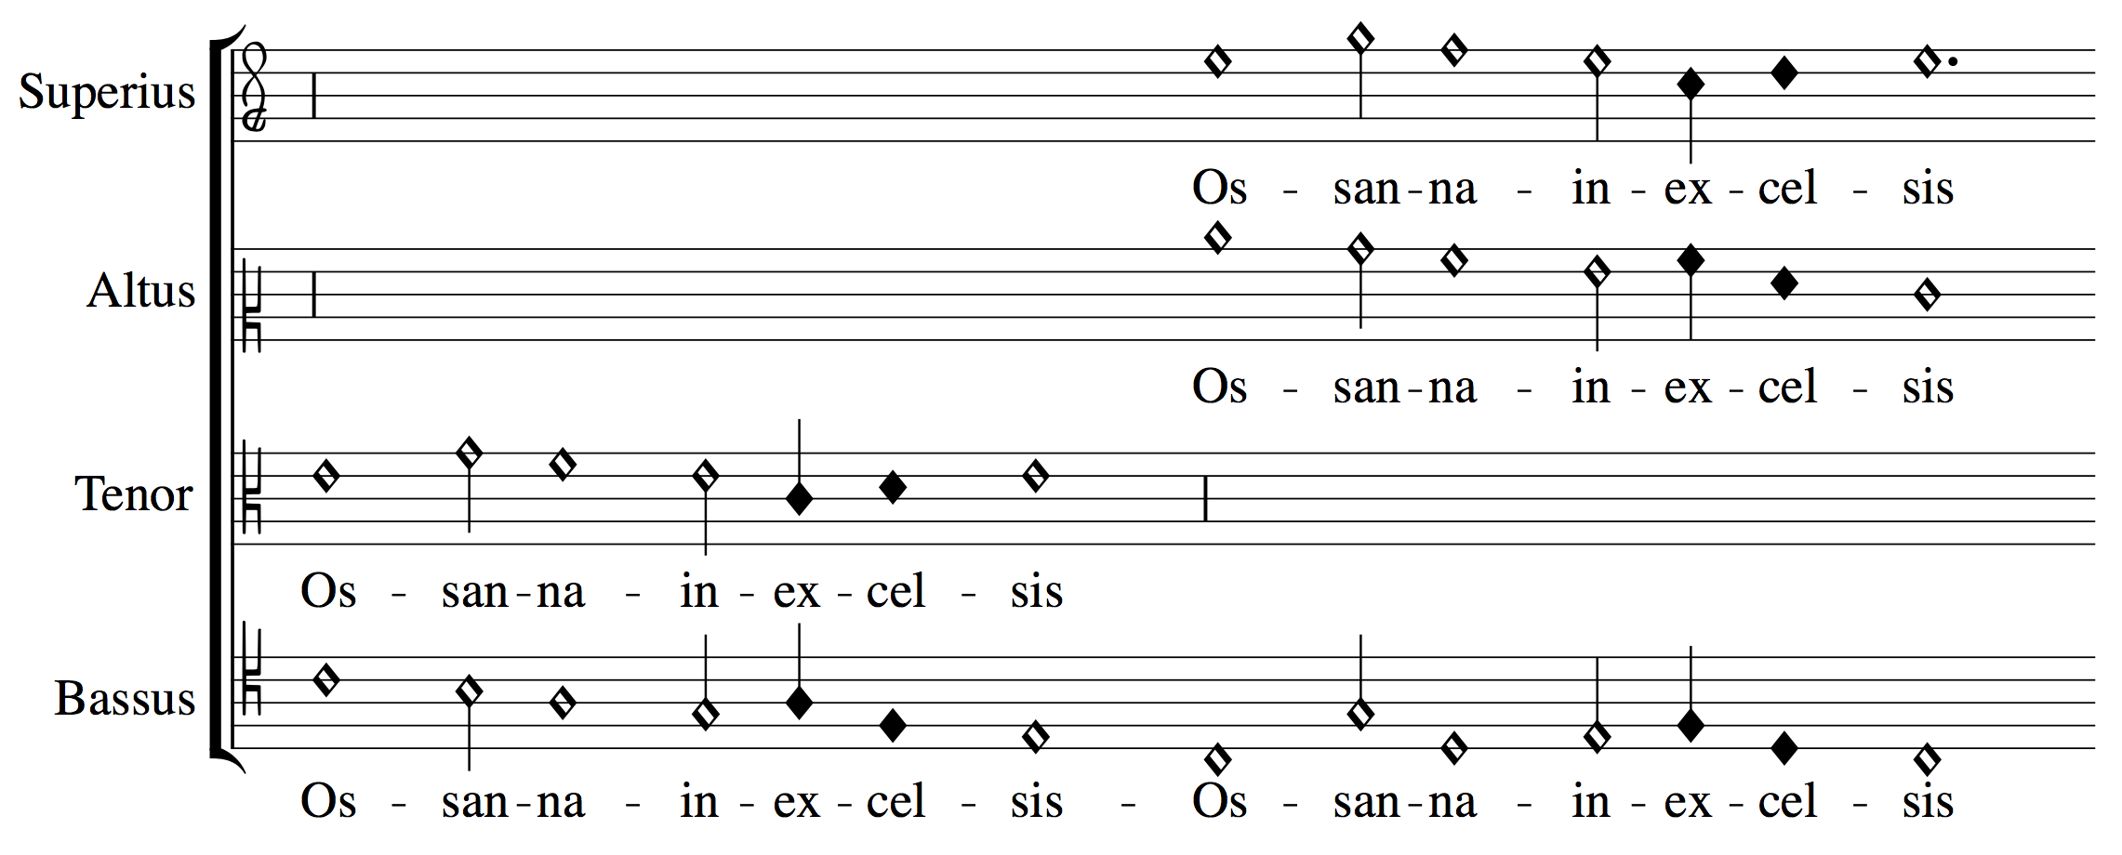
Barriers for Accessing the Music
SUPERIUS
ALTUS
Lack of high-quality digital images
Notation style (mensural notation)
Layout (choirbook format)
TENOR
BASSUS
Notes:
The layout doesn’t allow you to know which notes are sung together by the different voices at a particular time.
WHICH YOU WOULD KNOW IF THE PIECE WAS WRITTEN AS A SCORE
So, the issue is:
If you were in choirbook layout
To Know how the piece sounds like
4 experts singing each voice
OR 1 expert to transcribe the piece into a score
This separate-parts layout representation obscures certain information about the vertical intervals between the voices
SO, AS I SAID BEFORE, THE IDEA IS REMOVING THESE ACCESIBILITY BARRIERS, USING THE TECHNOLOGIES DEVELOPED AT THE DDMAL LAB

Slide 11
SIMSSA Tools
Note shape @dur
Pitch
@pname, @oct
Digitization
(DIY Book Scanner)
Optical Music Recognition (OMR)
Document Segmentation
(Pixel.js & Calvo's Method)
Symbol Recognition
(Interactive Classifier)
Pitch Finding
Correction
Mensural Scoring-up Tool
Duration
Perfect
Imperfect
Altered
@num, @numbase
Notes:
General OMR Workflow: preprocessing + symbol recognition (clefs, note shapes, etc.) + pitch finding (locate the notes in the staff and figuring out the pitch based on the clef) + correction stage
DIFF. SIMSSA TOOLS HAVE BEEN DEVELOPED FOR EACH OF THESE STAGES
--> talk in next session
Starting point of this workflow are digital images
Prepend digitization step:
- Antiquity --> no flatbed scanner
- Book Scanner (cameras over head)
-> NO approp. for the large dimensions of the books
buying is not an option --> DIY [I WILL TALK ABOUT IT SOON]
INFORMATION ABOUT THE NOTES IN THE MSS IS EXTRACTED IN THESE TWO STAGES [CLICK]
Note shape (attrib)+ Pitch (attrib)
Would be enough in CWMN (and in chant)
NOTE SHAPE IS NOT ENOUGH IN MENSURAL NOTATION TO DETERMINE THE DURATION OF THE NOTE
Need for the scoring up
“Expert” interpreting the duration of the notes based on the context
P / I → attrib.
These steps will be discussed in another talk → I will focus on the other two

Slide 12
Three Stages of the Project
Digitization
(DIY Book Scanner)
Optical Music Recognition
(OMR)
Mensural
Scoring-up Tool
Lack of high-quality digital images
Notation style
Layout
Notes:
[ FOCUS ON THESE TWO
BLACK BOX ]
THIS (1) SOLVES THE DIGITIZATION BARRIER
THIS (3) SOLVES THE OTHER TWO BARRIERS: NOTATION AND LAYOUT
THIS (2) IS THE STEP THAT CONNECTS THESE TWO (DIGITAL REPRESENTATION TO A SYMBOLIC ONE)

Slide 13
Three Stages of the Project
Digitization
(DIY Book Scanner)
Optical Music Recognition
(OMR)
Mensural
Scoring-up Tool
Guatemala
DDMAL Lab, McGill University
Notes:
PILOT PROJECT
Approached the archive: July
Advised --> One book first (pilot project)
November --> digitization options & paper conservators
January --> digitization process
1 → Done in Guatemala (actually I concluded this stage on January)
2 & 3 → conducted at the DDMAL Lab at McGill University

Slide 14
Digitization
(DIY Book Scanner)
Optical Music Recognition
(OMR)
Mensural Scoring-up Tool

Slide 15
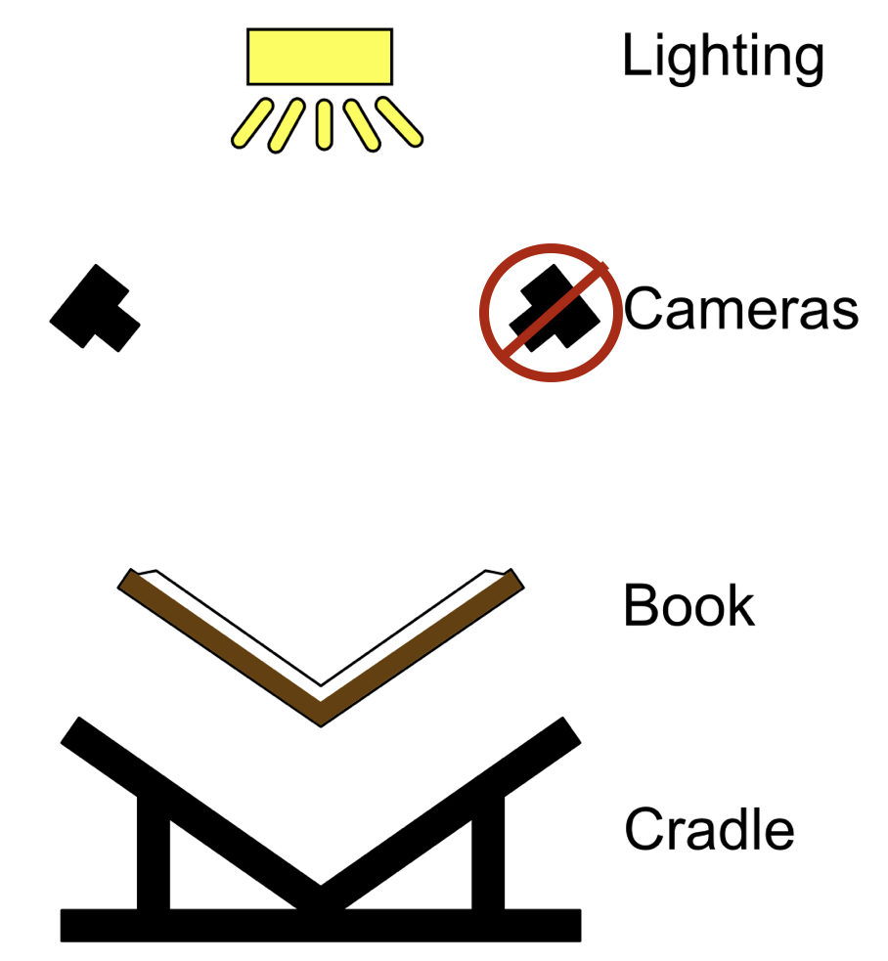
DIY Book Scanner
V-shaped book cradle
Built
Camera(s)
Borrowed from the McGill Music Library
Nikon D750 (24 Megapixels)
Images obtained have a 300 dpi resolution
Lighting
Borrowed from DDMAL Lab, McGill University
Two natural-light LED panels
DIY Book Scanner. “Book Scanner Rigs.”
http://diybookscanner.org
Notes:
1) Cradle → V-shaped:
To reduce the stress in the book’s spine
2) Cameras (Nikon D750 with 24 Megapixels = 6016 x 4016 pixels)
Perpendicular to the surface (the page) being photographed
You can have two for saving time
Or just one
You would just have to photographed all the versos first,
Then turn the book around,
And photograph all the rectos
3) Lighting
Resemble natural light
4) Glass platen → NO!
Everything was built or borrowed ☺
( And go through the details in the slide (build / borrow from & specificities) )

Slide 16
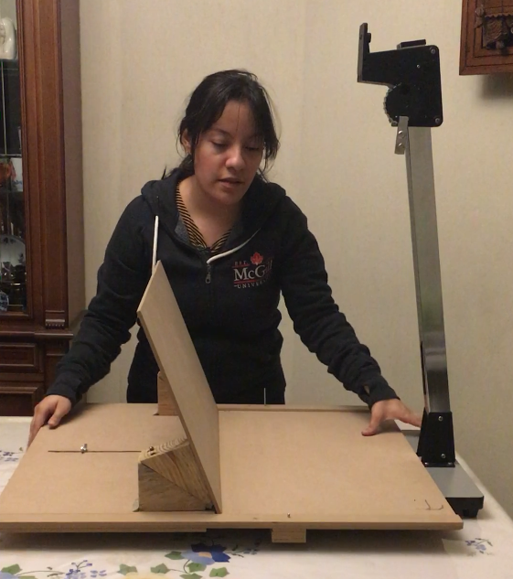
The V-Shaped Book Cradle & Copy Stand
Notes:
Opened at 110 degrees
Actually, this cradle allowed for two configurations
The other is this one (face up)
We preferred using this one since it was easier to:
Set the camera perpendicular to the page (one variable instead of two)
Keep the distance between the camera & the page constant (graded arm)

Slide 17
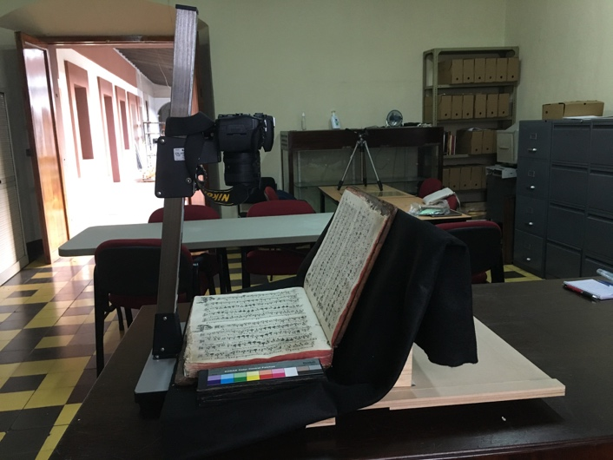
DIY Book Scanner
Notes:
Follow DIAMM’s specifications as much as possible (given their vast experience in digitization of music manuscript)
Black felt (for regular background and avoiding reflections)
Color patch & size scale AND having them at the same height as the surface being photographed
https://journal.digitalmedievalist.org/articles/10.16995/dm.16/

Slide 18
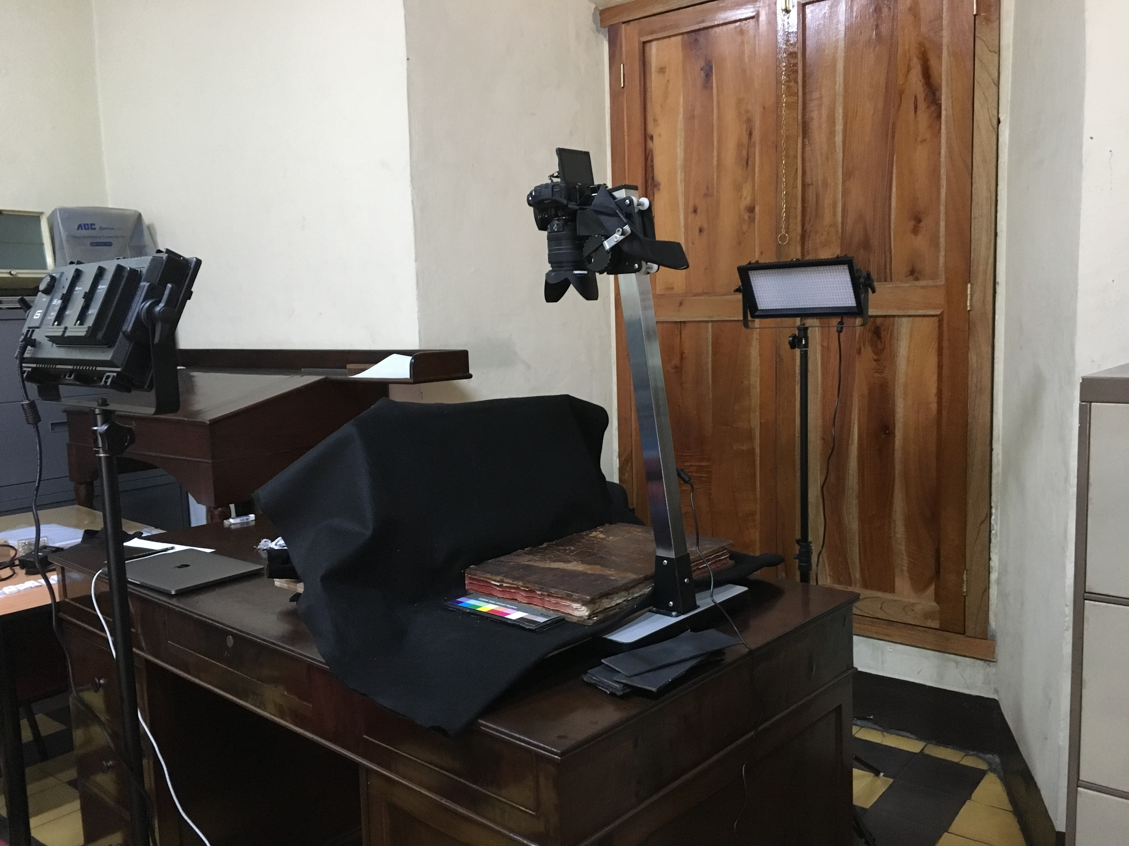
Lighting
Notes:
Lots of lighting
Both sides (even distribution of the light)
And that they are placed on an angle that avoids reflections in the camera

Slide 19
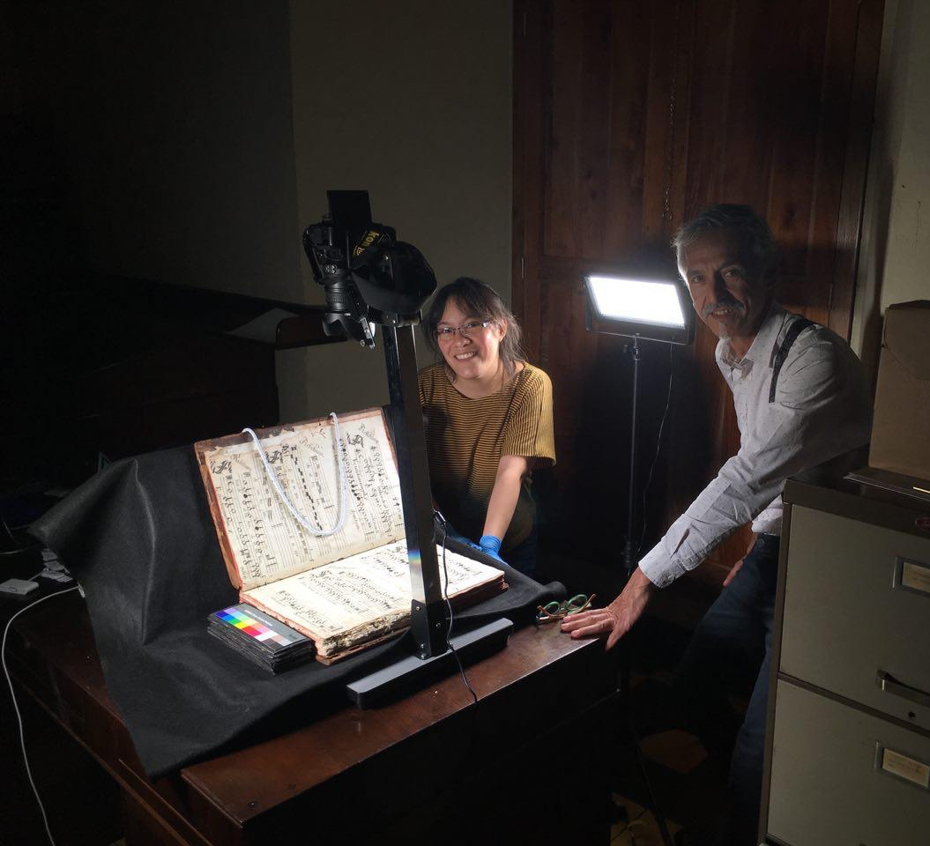
DIY Book Scanner
Notes:
Here:
The photographer that made the setup before I started shooting
And I am the one handling the manuscript (see nitrile gloves)

Slide 20
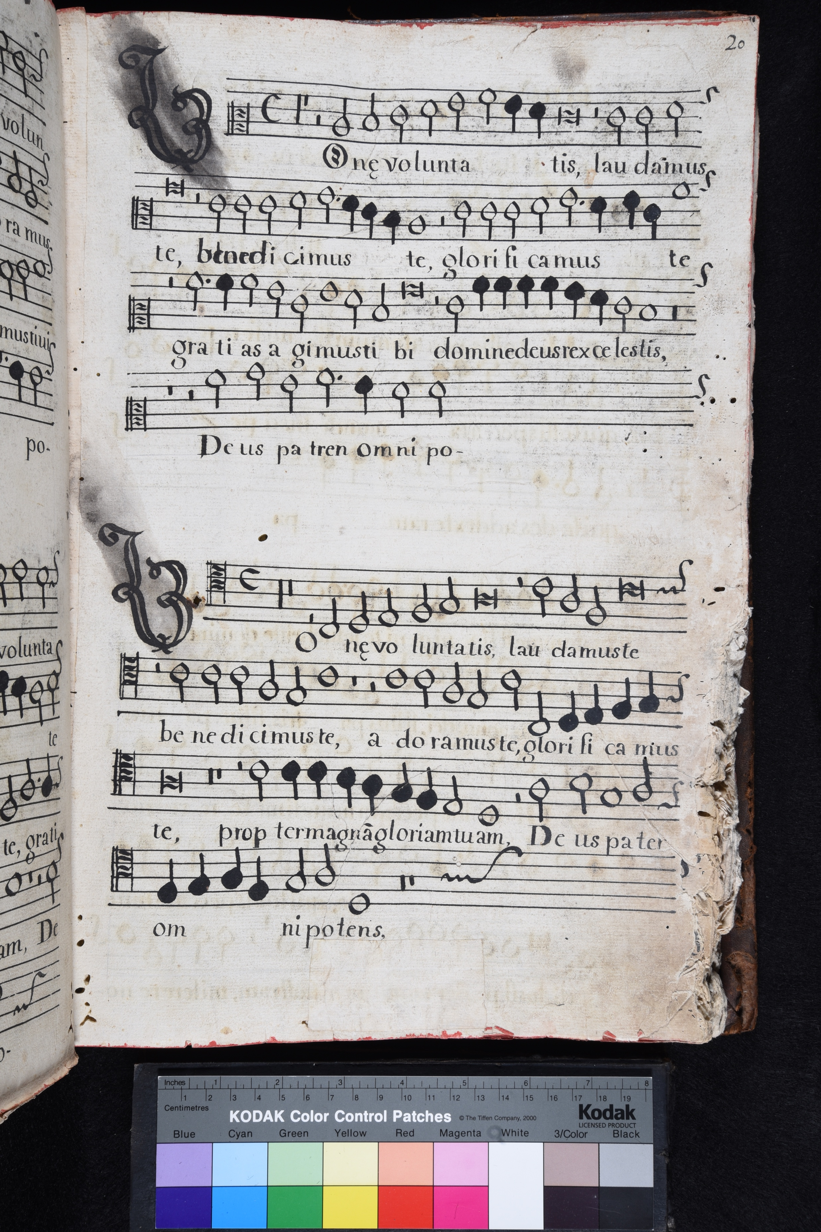
Comparison

Slide 21
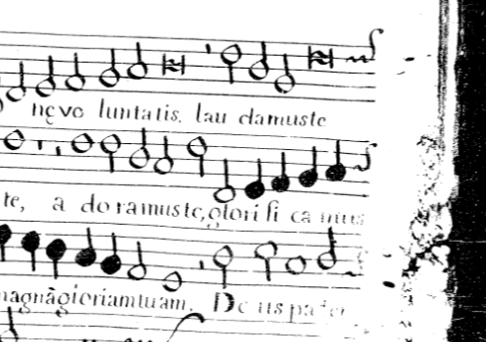
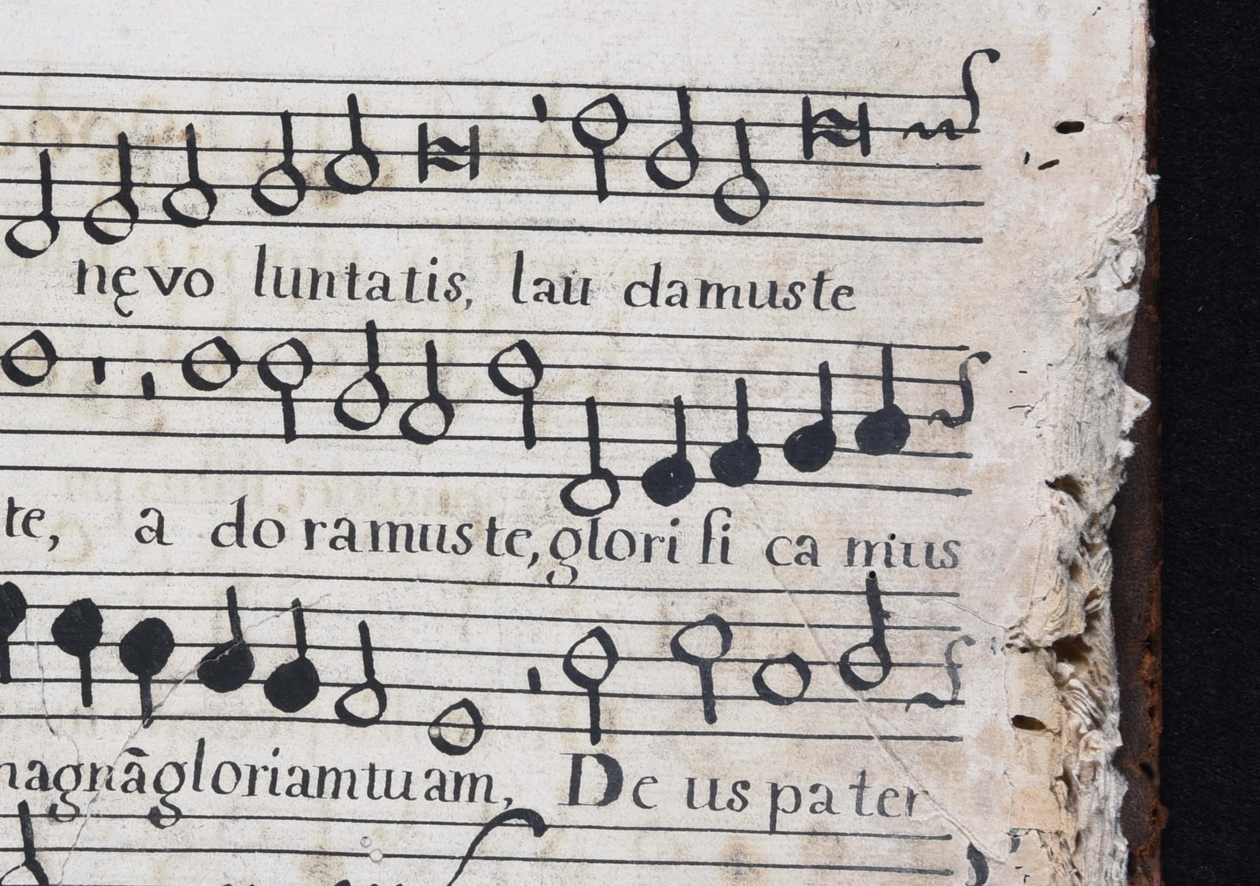
Comparison

Slide 22
Digitization
(DIY Book Scanner)
Optical Music Recognition
(OMR)
Mensural Scoring-up Tool

Slide 23
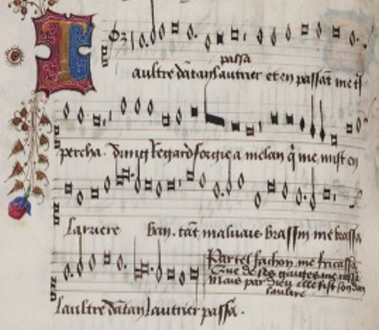
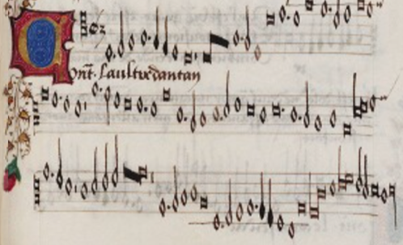

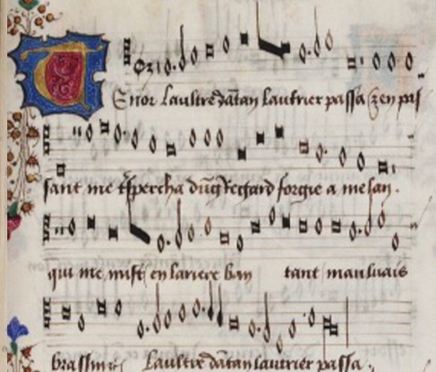
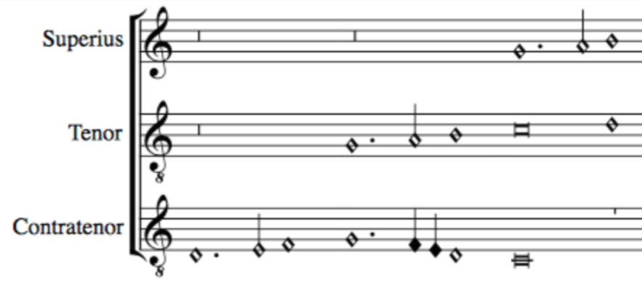
Pitch
Note shape
Mensural MEI file
_______
_______
Scoring-up
Tool
Duration based on context
Merge all files together
OMR
Mensural
MEI file
________
________
________
________
Superius part
OMR
Mensural MEI file
_______
_______
Contratenor part
SCORE
Mensural MEI file
_______
_______
OMR
Tenor part
Notes:
Musical content encoded as scores
more familiar format for modern musicians
encoded --> play it back
score --> vertical sonorities (counterpoint studies)

Slide 24
Expected Results
Digitization
Document Segmentation
Symbol Recognition
Pitch Finding
Correction
Scoring-up Tool
Digitization and encoding of the repertoire as musical scores in a machine-readable file format
Facilitate its preservation, dissemination, study by musicologists, and appreciation by the general public
We expect this research to be used as a model for the digitization of the mensural repertoire of other countries that were once part of the colonial past
Notes:
Musical content encoded as scores
more familiar format for modern musicians
encoded --> play it back
score --> vertical sonorities (counterpoint studies)
ACCESS both INSIDE and OUTSIDE Guatemala

Slide 25



Thank you! martha.thomaeelias@mail.mcgill.ca

